Slide 1

Module introduction & Assignment briefing
MARK1152 Relationship Marketing and the Customer Experience
Dr Zohre Mohammadi

Slide 2
This is a 15-credit core module for MA International Event Management students
It is block-taught over the first half of the term
Mondays 11-1 (double lecture)
Tuesdays 12-2pm (Tutorial 1-double tutorial)
Tuesdays 4-6pm (Tutorial 2-double tutorial)

Slide 3
Making an appointment
If you would like to make an appointment, please email to arrange a convenient day and time.
z.Mohammadi@greenwich.ac.uk
Meetings can take place face to face or on Teams

Slide 4
Learning Outcomes
To manage your learning experience on this module including reading and assessment
To be able to access the resources you need with confidence
To appreciate why it is important for you, as an MA events student, to study relationship marketing and the customer experience

Slide 5

Module Aims
To reflect on the role of relationship marketing as a paradigm, strategy and activity in the changing landscape of marketing.
To critically examine the key concepts and theories of relationship marketing in various contexts.
To explore the field of experiential marketing and events as platforms for creating customer experiences and building relationships.
To relate theory to the practice of managing customer relationships.

Slide 6
The conceptual framework of the module
Relationship Marketing
Experiential Marketing
Event Marketing

Slide 7
Module Design – 2 topics covered each week
Week 19 – Introduction to Module & Assignment Briefing (1) & Marketing as a Paradigm (2)
Week 20 – Event Marketing Contexts (3) & Relationship Marketing Theory (4)
Week 21 - Understanding the Customer Experience (5) & Customer Experience and Customer Loyalty (6)
Week 22 – Creating events for different customer segments (7) & Events as platforms for building relationships (8)
Week 23 – Co-creating relationships and experiences through technologies/social media (9) & creating an experiential and relationship marketing plan (10)
Week 24 – Assignment support: Marketing Plan briefing and Q&A/peer-to-peer assignment discussions (11 & 12)

Slide 8
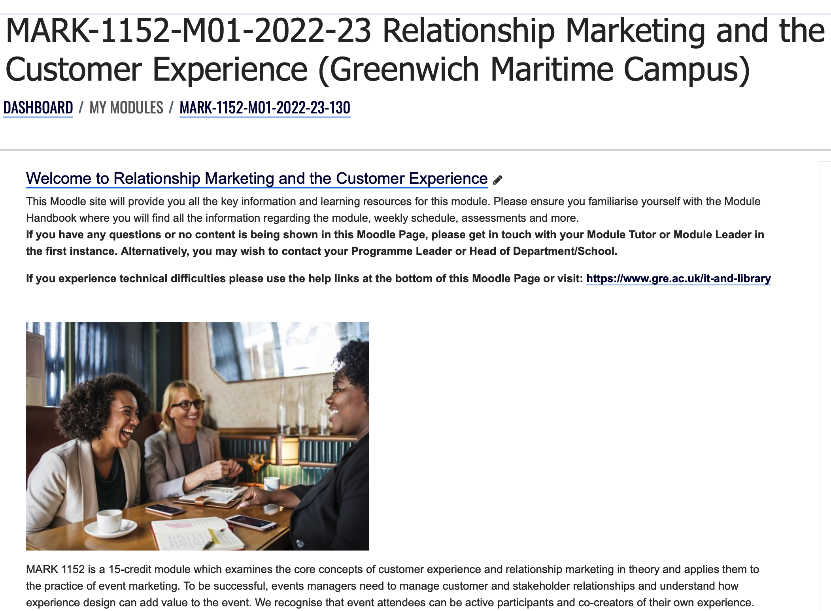
Moodle Site
MARK 1152

Slide 9

Module Reading
There is not one core textbook. I have created links to the key readings (mainly academic journal articles) under the topic being covered
The weekly readings appear on Moodle and in the Module Handbook on pages 6-7 Schedule of Teaching and Learning Activities

Slide 10
Different purposes of reading
Background reading for each topic is to deepen your knowledge of the subject
Tutorial reading which you must do in order to participate fully in the tutorial
Assessment reading which you must do to prepare for your assessment includes articles I have uploaded on Moodle as well as your own research

Slide 11

Module Assessment
Formative student-led presentation – 0%
Designed to prepare you for the marketing plan
Summative assessment: Marketing Plan – 100%
Designed to assess your ability to critically engage with relationship marketing and customer experience literature and apply to an event or a brand using events as a marketing tool

Slide 12
Your formative presentation assessment
Students get into groups of five and prepare a short (10 minute) presentation applying the theories from the topic readings to an event marketing context.
I will upload all the presentations onto Moodle as resources for your essay assignment.

Slide 13
Formative Presentation Topics and Dates
Topics
Different perspectives of the event customer experience
The influence of customer experience on relationship marketing outcomes
Co-creating events for different customer segments
Events as value-creating spaces for relationships and experiences
Building customer relationships through technologies and social media
Creating customer experiences through technologies and social media
Week beginning 30/01/23
Week beginning 06/02/23
Week beginning 13/02/23

Slide 14
Assessment Task
Assessments | Deadline | Weighting | Maximum length
Marketing Plan | 6th March 2023 by 23:30 | 100 % | 3000 words*
+/- 10%
The wordcount does NOT include the reference list or appendices

Slide 15
Marketing Plan brief (see module handbook pages 8-10)
Students will write a 3000-word (-/=10%) marketing plan for an existing event.
The first section of the plan requires you to research the current marketing situation of your chosen event.
The second section requires you critically review the relationship marketing and the customer experience theories and literature and create a theoretical framework for your event’s marketing.
The third section requires you to apply the theoretical framework to create a programme of marketing activities for a specific customer segment.

Slide 16
The Marketing Plan should be structured like a business report
Title Page
Contents Page
Marketing plan background
The theoretical framework
Implementation plan
List of References
Appendices if required

Slide 17
1. Marketing Plan background
1.1. Brief overview of the event you have chosen for this assignment
1.2. Brief overview of their current marketing situation

Slide 18
2. The theoretical framework
2.1. Relationship marketing
2.2. Customer experience
2.3. Theoretical framework for the event’s marketing

Slide 19
3.Implementation plan
3.1. Customer segmentation
3.2. Marketing programme of activities

Slide 20

Writing in a business report format
Title page
Contents page with headings and page numbers
Page numbering
Clear and professional layout and structure
Number the report sections and use headings e.g.
1. Marketing plan rationale
1.1. Brief overview of the event or brand

Slide 21

Writing a business report
Write in full sentences
Use in-text citations
Do not use I – if you are referring to yourself please do so in the third person e.g. the author
Use formal language
Use correct grammar, spelling, punctuation and sentence structure

Slide 22

A critical perspective is required
Remember to take a critical perspective throughout your marketing plan and justify what you are proposing with support from the literature and theory

